Slide 1
Accelerating Mixture of Experts Model Inference

Slide 2
Content
Basic MoE models
Parallel deployment
Systems
Discussions

Slide 3
Basic MoE Models

Slide 4
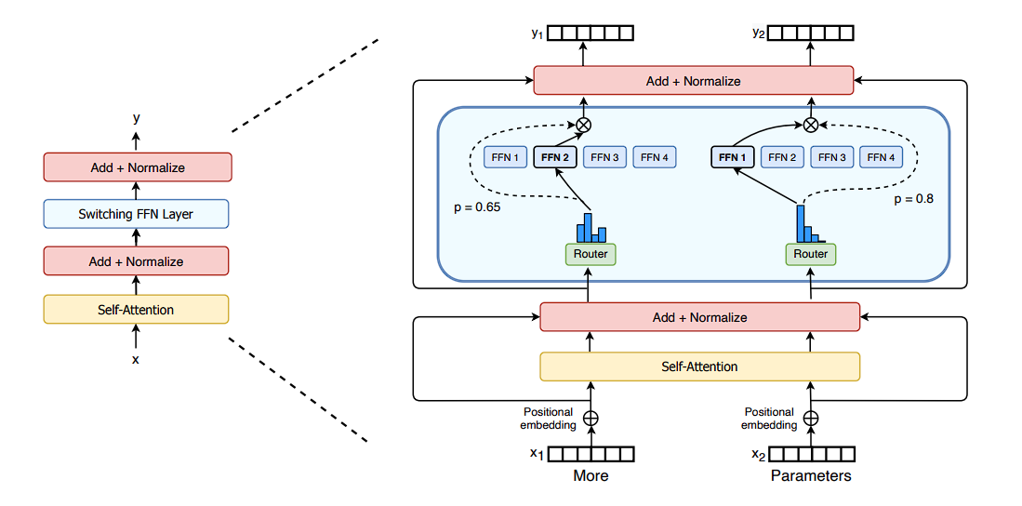
Sparse Scaling of the Transformer Architecture
Token-wise router mechanism
Duplicate FFNs——Experts

Slide 5
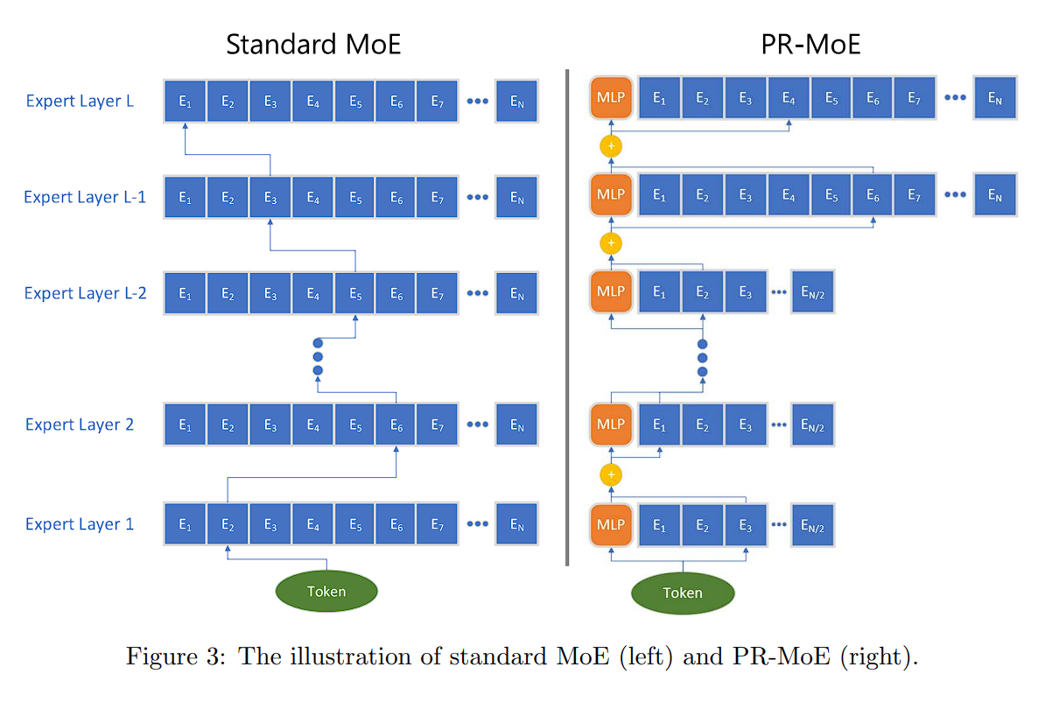
Variants with Shared Experts
Deepspeed propose pyramid and residual moe

Slide 6
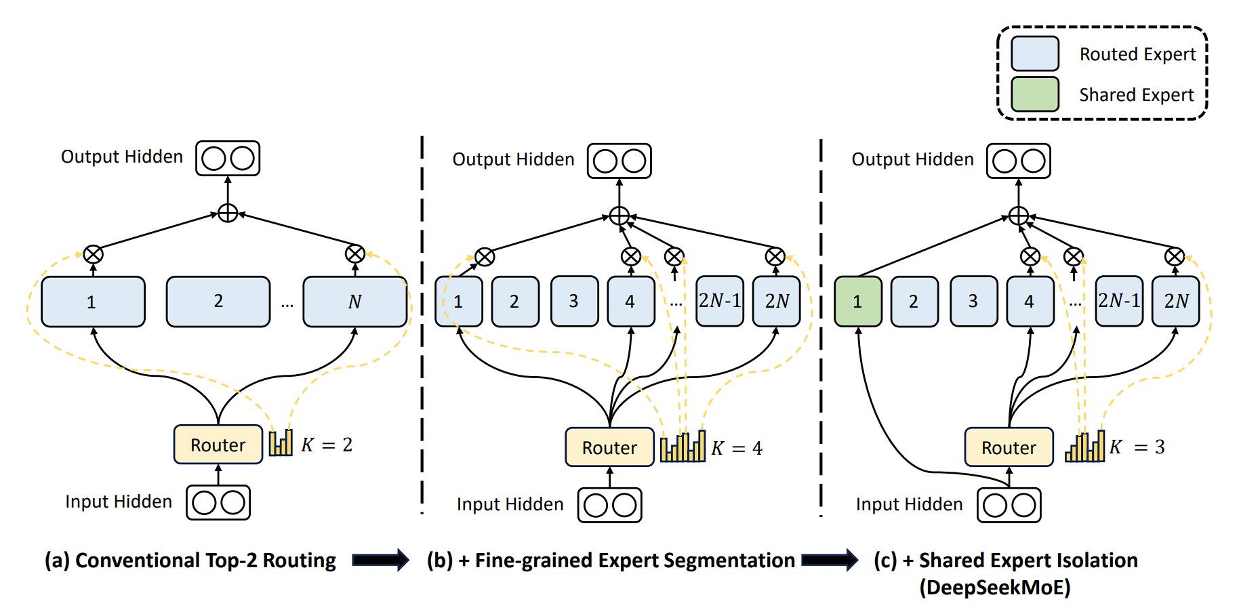
Variants with Shared Experts
Deepspeed propose pyramid and residual moe arch
Deepseek follow the shared experts and use fine-grained moe experts

Slide 7
Benefits
Sub-linear scaling of computation cost vs model size

Slide 8
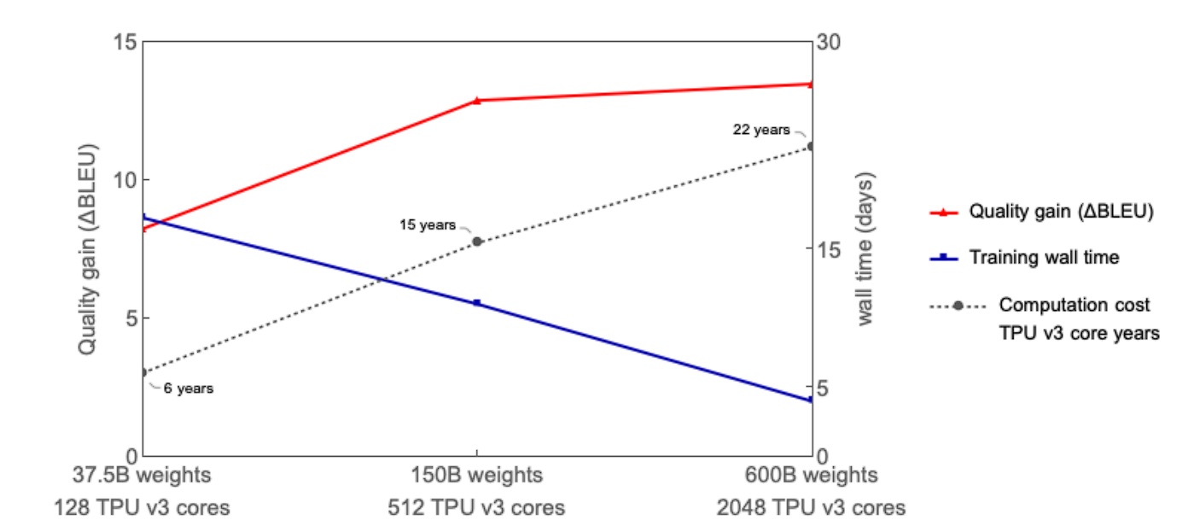
Benefits
Sub-linear scaling of computation cost vs model size

Slide 9
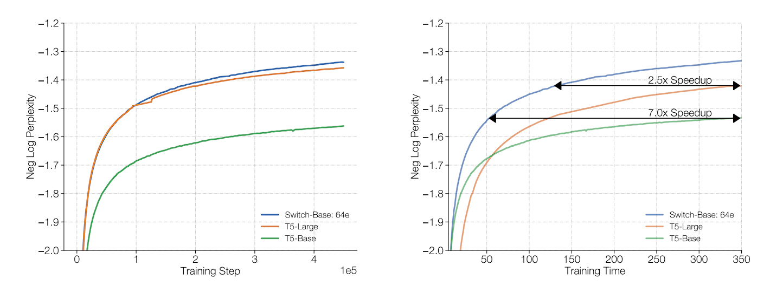
Benefits
Sub-linear scaling of computation cost vs model size
Less training and inference overhead

Slide 10
Benefits
Sub-linear scaling of computation cost vs model size
Less training and inference overhead
Architecture-specific model parallelism support

Slide 11
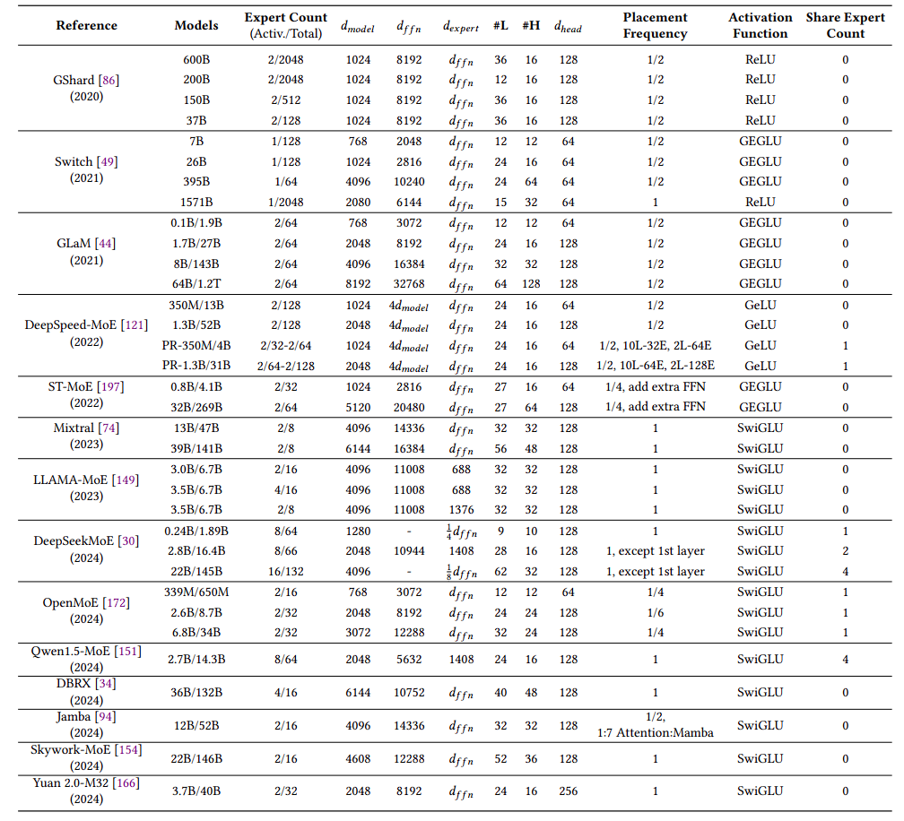
Popular MoE models
Trends
Stable expert number open-sourced(at most 128)
Shared experts and fine-grained experts
More frequent models in MoE

Slide 12
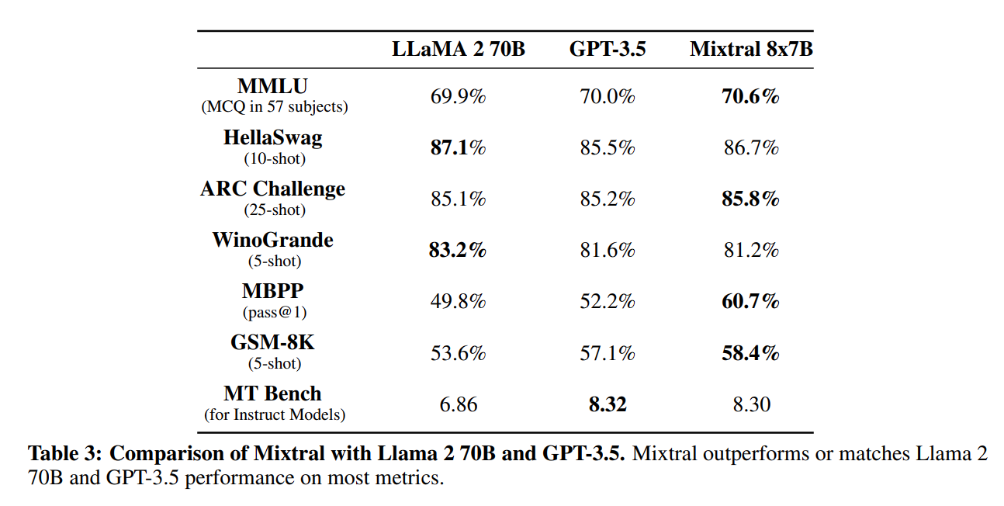
Popular MoE models
Mixtral 8*7B——2023.12
Activate 13B
Outperform or match LLaMA2 70B and GPT-3.5

Slide 13
Parallel Deployment

Slide 14
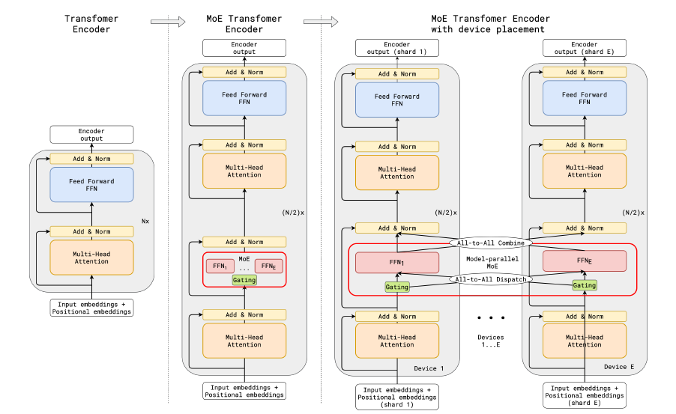
Expert Parallel
Experts deployed on different devices

Slide 15
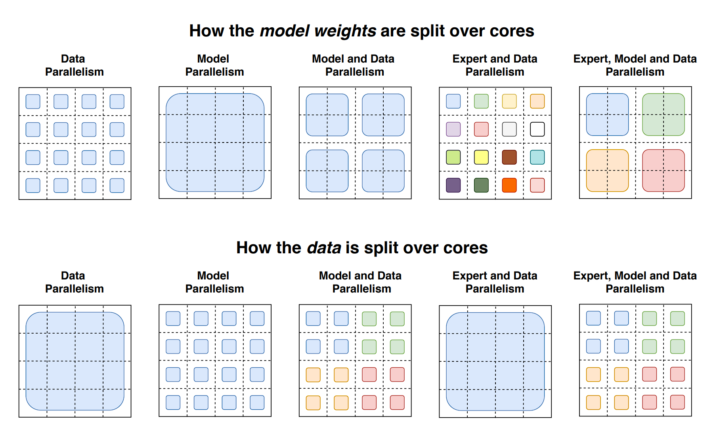
Hybrid parallel strategies
DP/TP/EP/PP

Slide 16
Systems

Slide 17
MoE Inference Systems
Title | Conference | Date
DeepSpeed-MoE: Advancing Mixture-of-Experts Inference and Training to Power Next-Generation AI Scale | ICML | 2022.1
Towards MoE Deployment: Mitigating Inefficiencies in Mixture-of-Expert (MoE) Inference | Arxiv | 2023.3
SE-MoE: A Scalable and Efficient Mixture-of-Experts Distributed Training and Inference Algorithm-System | Arxiv | 2023.6
Accelerating Distributed MoE Training and Inference with Lina | ATC | 2023.6
TUTEL: ADAPTIVE MIXTURE-OF-EXPERTS AT SCALE | MLsys | 2023.6
Optimizing Dynamic Neural Networks with Brainstorm | OSDI | 2023.7
MoE-Infinity: Activation-Aware Expert Offloading for Efficient MoE Serving | Arxiv | 2024.1
SiDA-MoE: Sparsity-Inspired Data-Aware Serving for Efficient and Scalable Large Mixture-of-Experts Models | MLsys | 2024.5

Slide 18
Deepspeed-MoE Inference System
Key Challenge
4x larger MoE model size than quality-equivalent-dense models (QEDM)
Requires 4x higher bandwidth/parallelism/scalability for latency parity
Goal:
Achieve aggregate memory bandwidth across hundreds of devices

Slide 19
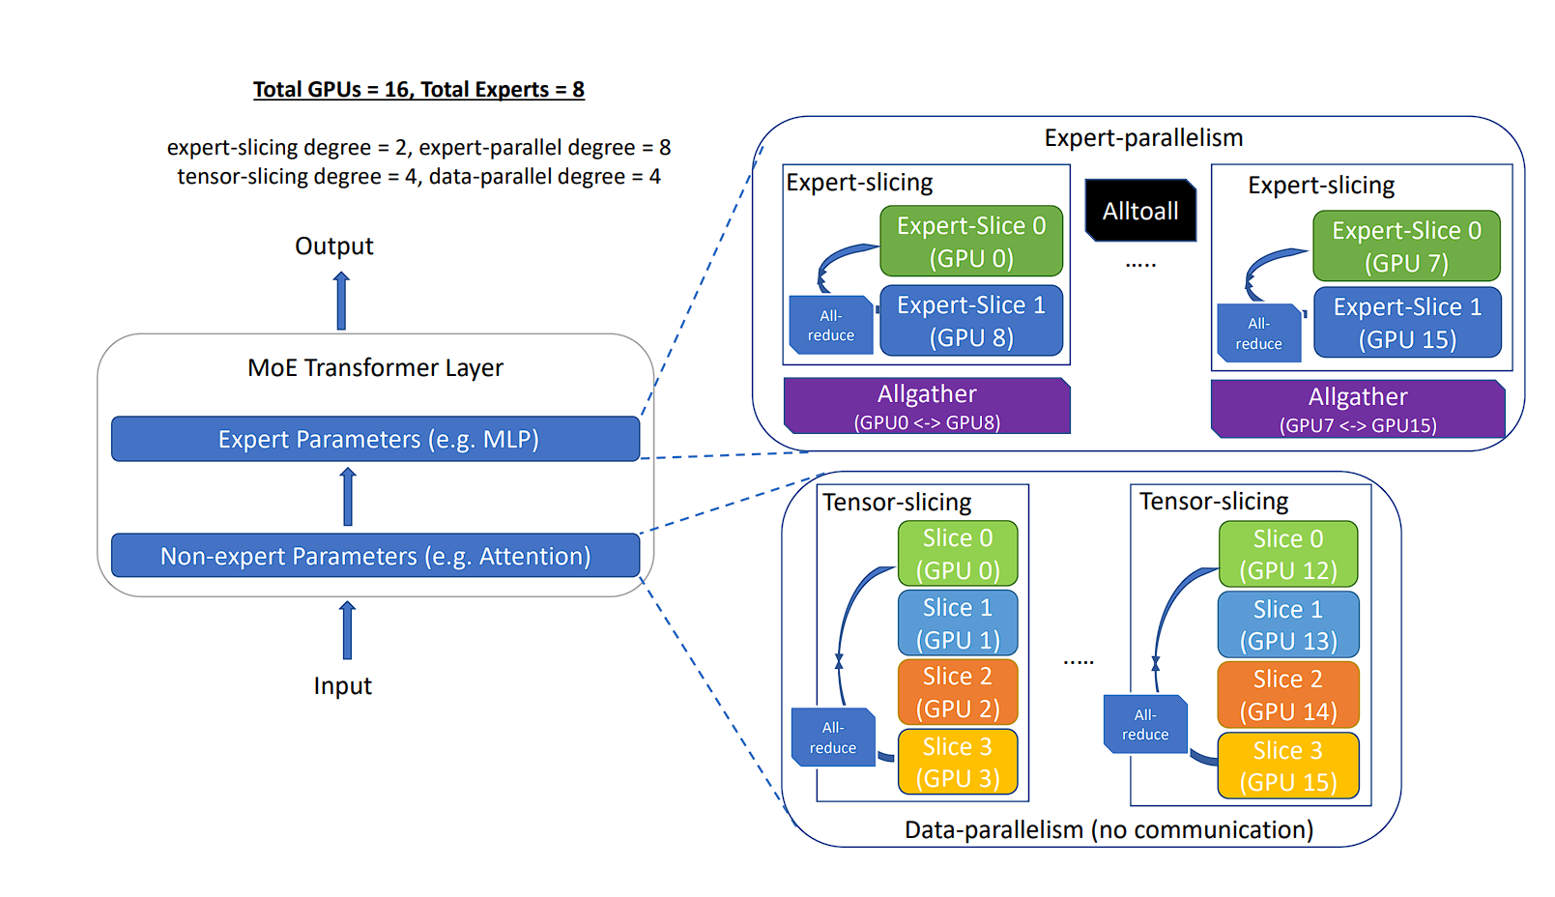
Deepspeed-MoE Inference System——Optimizations
A symphony of parallelism
Careful orchestration of tensor, data and expert parallelism

Slide 20
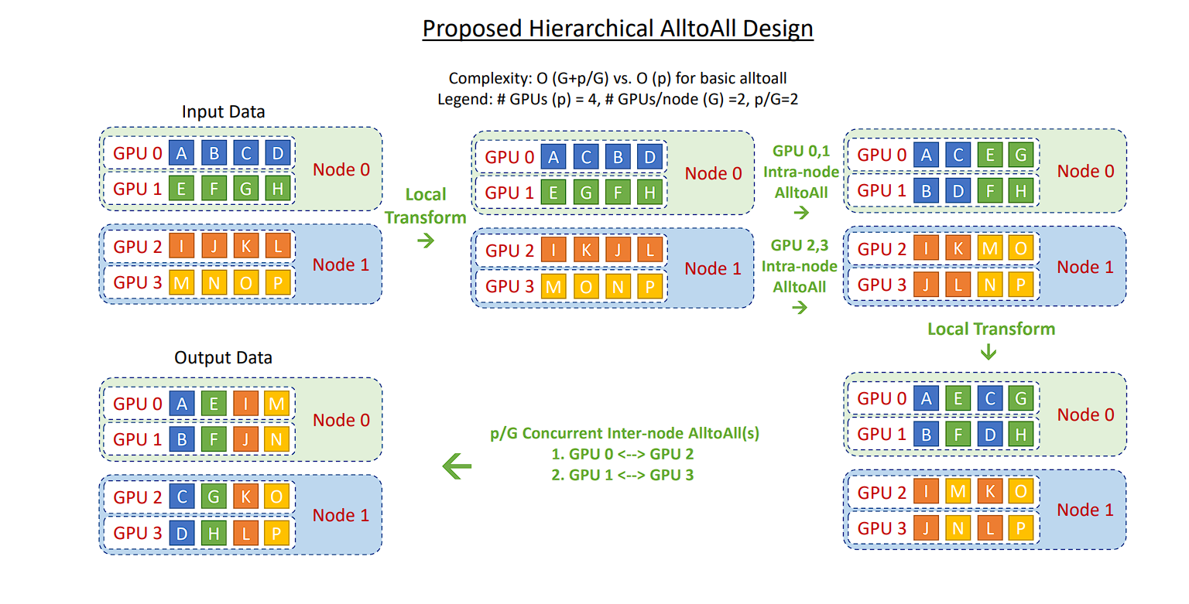
Deepspeed-MoE Inference System——Optimizations
Parallelism coordinated Communication Optimization Strategies
Minimize communication overhead
Reduces the communication hops from O(p) to O(G+ p/G)

Slide 21
Deepspeed-MoE Inference System——Optimizations
Parallelism coordinated Communication Optimization Strategies
Minimize communication overhead
Kernel Optimizations
Maximize bandwidth utilization per device

Slide 22
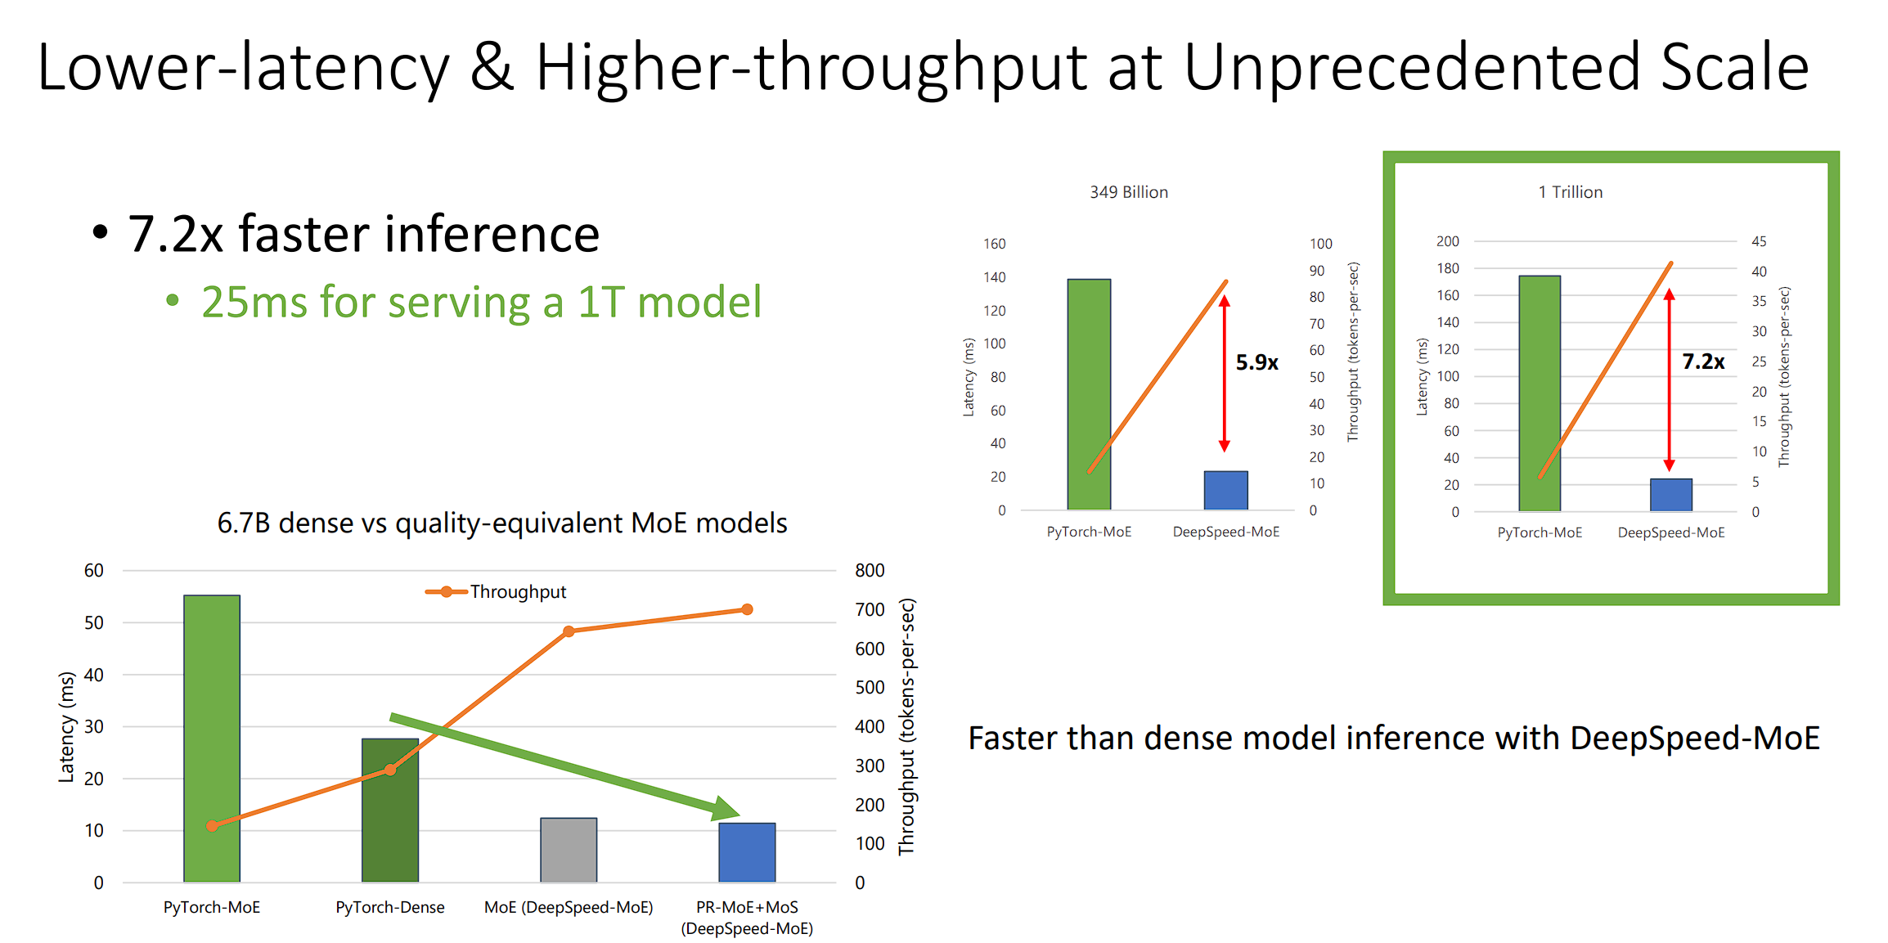
Deepspeed-MoE Inference System——Evaluation

Slide 23
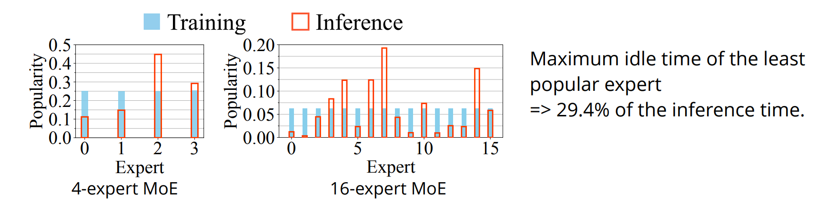
Lina——Challenge
Inference expert selection is workload-driven——much more biased
Devices with unpopular experts have to wait for those with popular experts.

Slide 24
Lina——Challenges
How to deal with imbalance computation load?
Popular experts => more resources
How to achieve low-overhead resource scheduling?

Slide 25
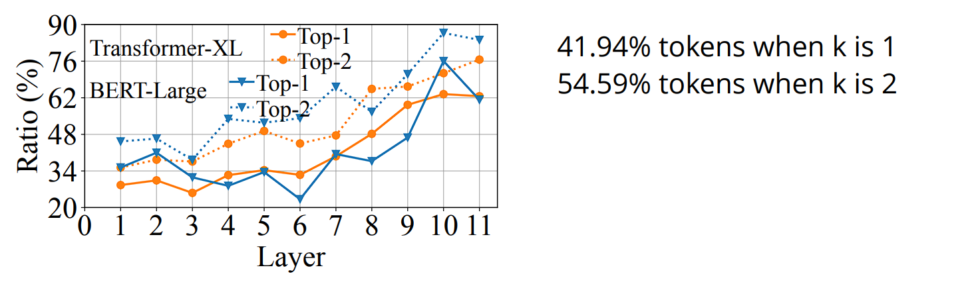
Lina——Expert Selection Pattern
Findings: similar tokens tend to be processed by the same or similar experts in each layer.
Tokens selecting the same expert in layer i tend to select the same expert again in layer i + 1.

Slide 26
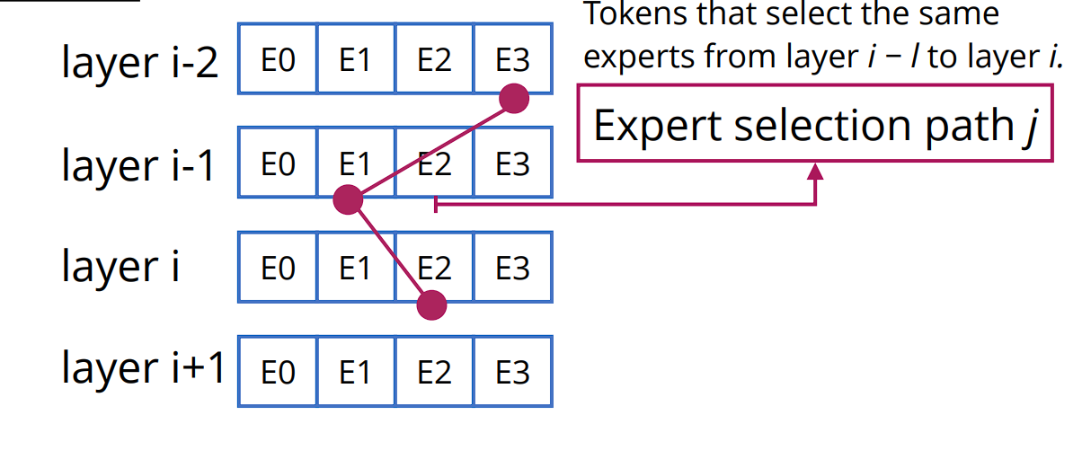
Lina——Expert Popularity Estimation
Idea: Collect the expert selection distribution during training after the load balancing loss is minimized.

Slide 27
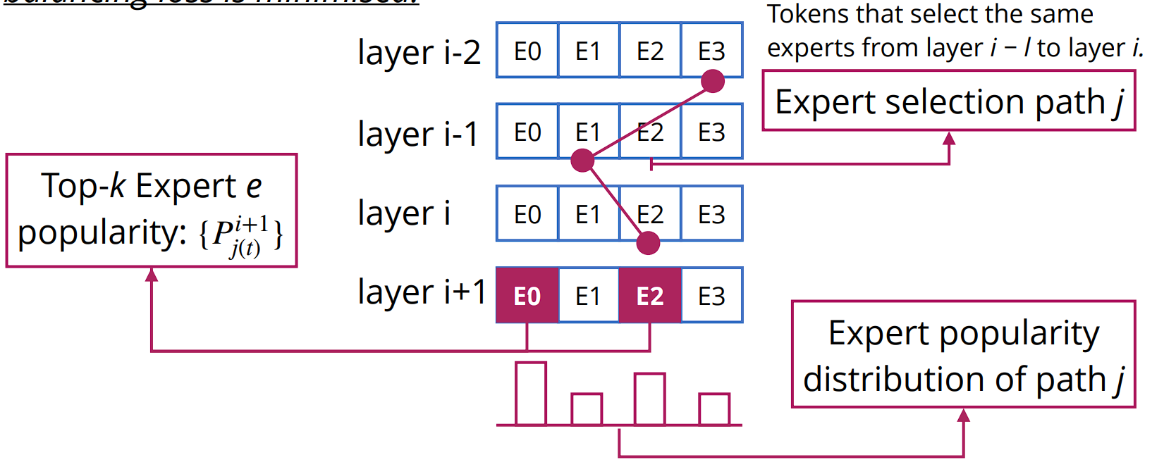
Lina——Expert Popularity Estimation
Idea: Collect the expert selection distribution during training after the load balancing loss is minimized.

Slide 28
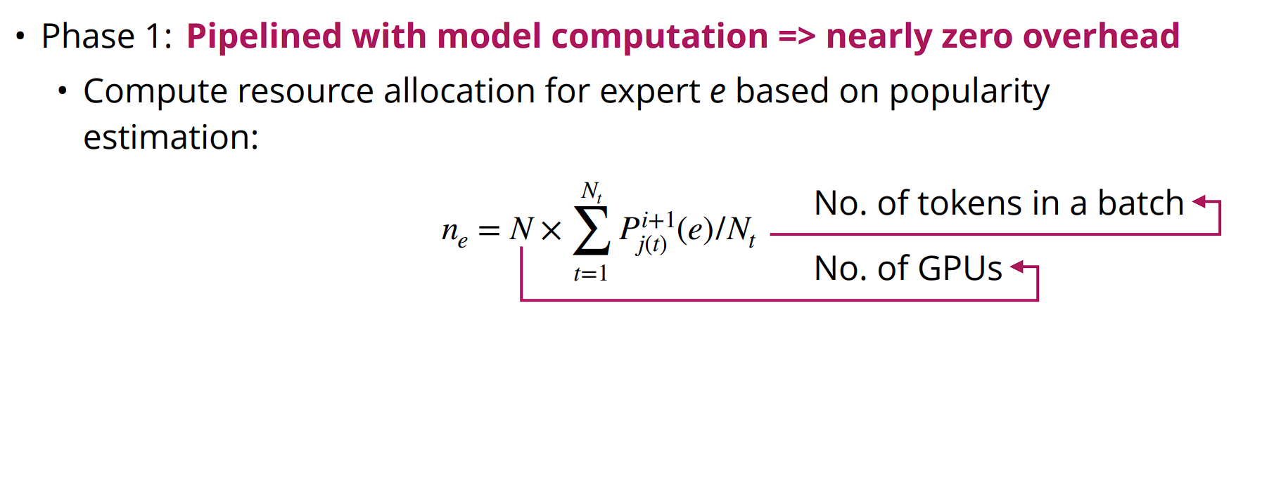
Lina——Two-phase Scheduling

Slide 29
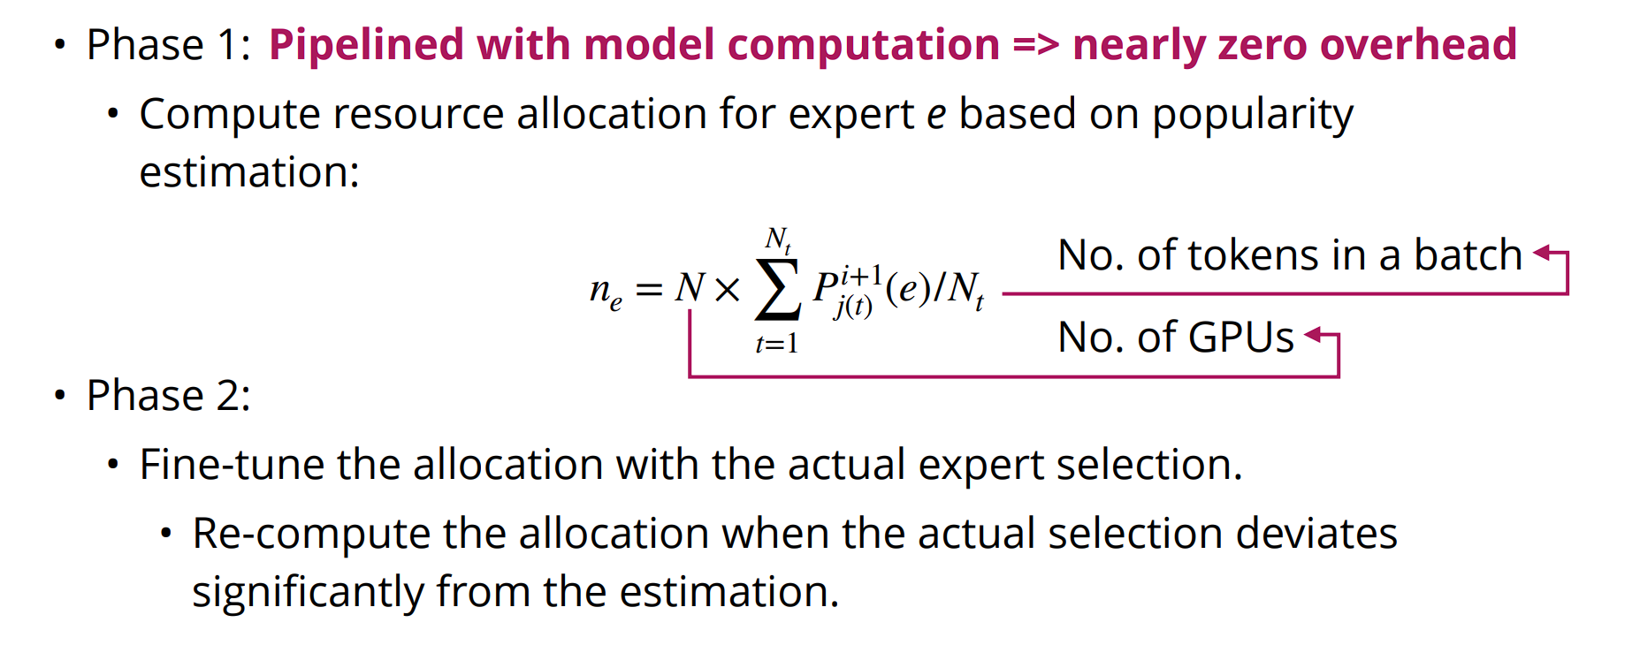
Lina——Two-phase Scheduling

Slide 30
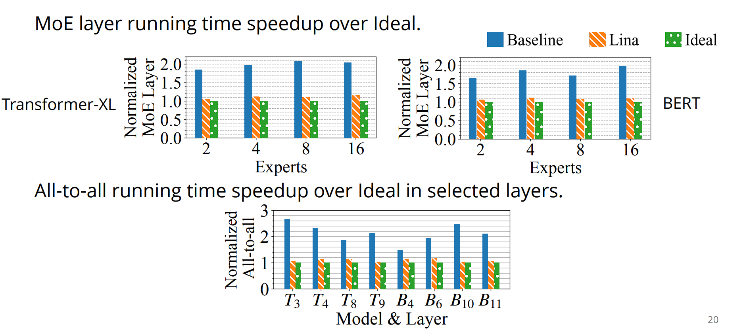
Lina——Evaluation

Slide 31
Discussion

Slide 32
Our findings
Offline global workload distribution mismatch runtime workload distribution
Offline prediction is unstable, runtime scheduling is needed

Slide 33
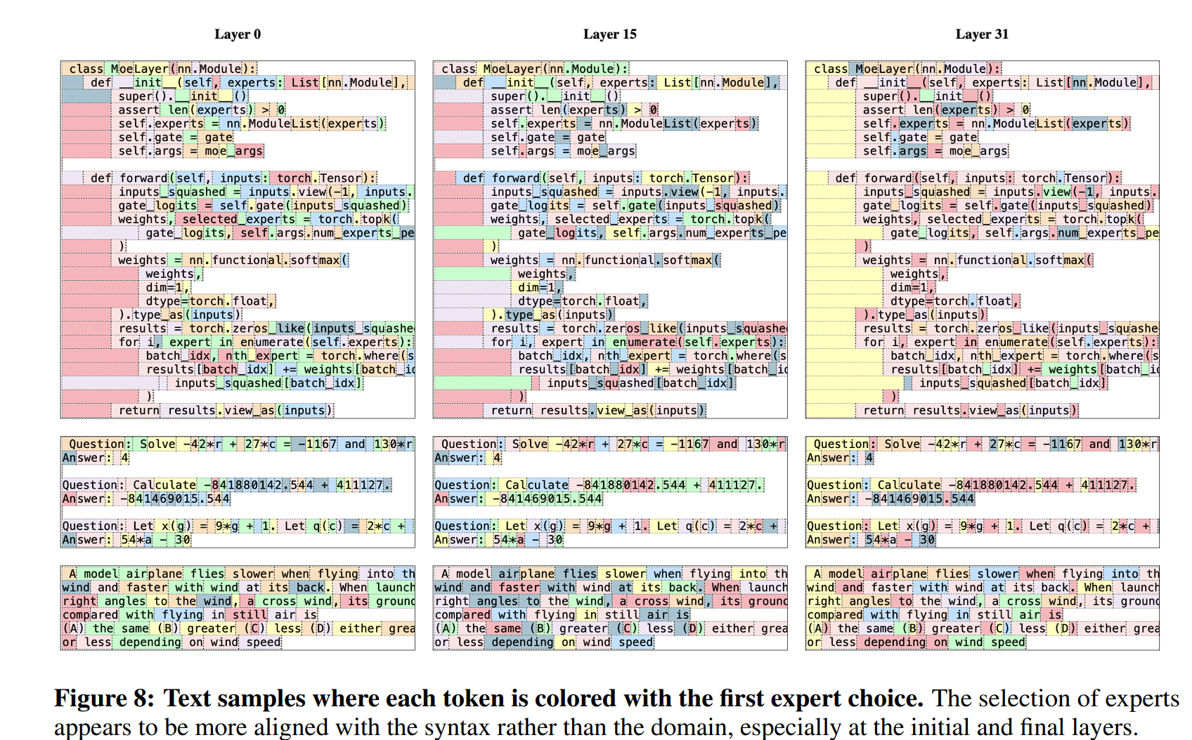
Our findings
Offline global workload distribution mismatch runtime workload distribution
Offline prediction is unstable, runtime scheduling is needed
Token specialization clustering
Predict token popularity from input

Slide 34
Our findings
Offline global workload distribution mismatch runtime workload distribution
Offline prediction is unstable, runtime scheduling is needed
Token specialization clustering
Predict token popularity from input
Shared expert and fine-grained expert parallel
Computing communication overlap

